Slide 1
Conic sections
Shreyas M
B.Tech in ECE PES University Bangalore

Slide 2
Chapter Map
Section | Topic
1 | Introduction
2 | General form of Conics
3 | Parabola
4 | Hyperbola
5 | Ellipse
6 | Circle
7 | Supplement : More on circles

Slide 3
1 Introduction
We have already done equation of straight lines and are well aware of its significance.
This chapter deals with the equations and parameters of the four basic curves that can be derived by intersecting a plane with cones which have a common vertex and axis. Hence these 4 curves are called ‘Conics’ or ‘Conic Sections’

Slide 4
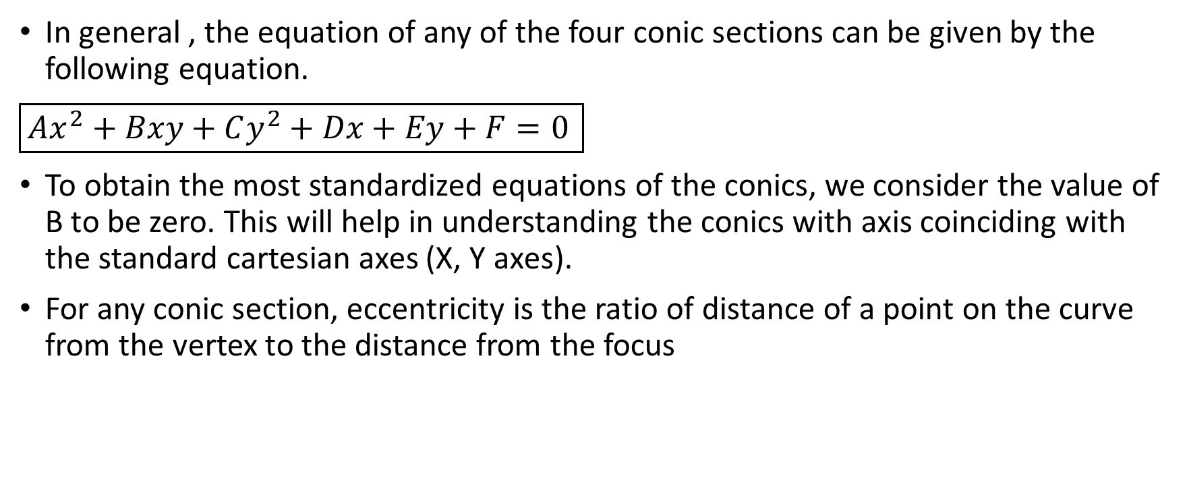
2 General form of conics
In general , the equation of any of the four conic sections can be given by the following equation.
$\boxed{Ax^{2}+Bxy+Cy^{2}+Dx+Ey+F=0 }$
To obtain the most standardized equations of the conics, we consider the value of B to be zero. This will help in understanding the conics with axis coinciding with the standard cartesian axes (X, Y axes).
For any conic section, eccentricity is the ratio of distance of a point on the curve from the vertex to the distance from the focus

Slide 5
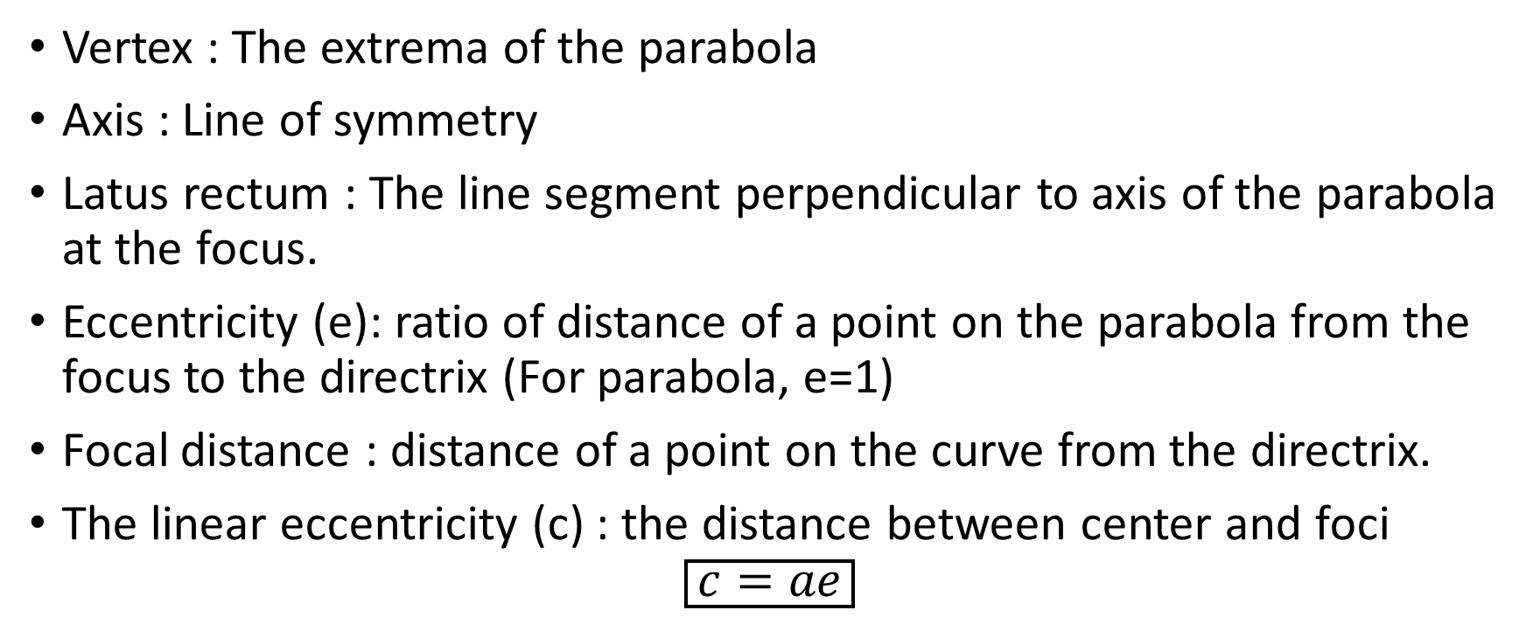
3 Parabola
Vertex : The extrema of the parabola
Axis : Line of symmetry
Latus rectum : The line segment perpendicular to axis of the parabola at the focus.
Eccentricity (e): ratio of distance of a point on the parabola from the focus to the directrix (For parabola, e=1)
Focal distance : distance of a point on the curve from the directrix.
The linear eccentricity (c) : the distance between center and foci
$$\boxed{c=ae}$$

Slide 6
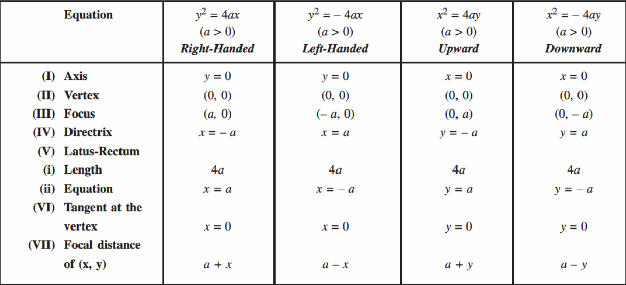

Slide 7
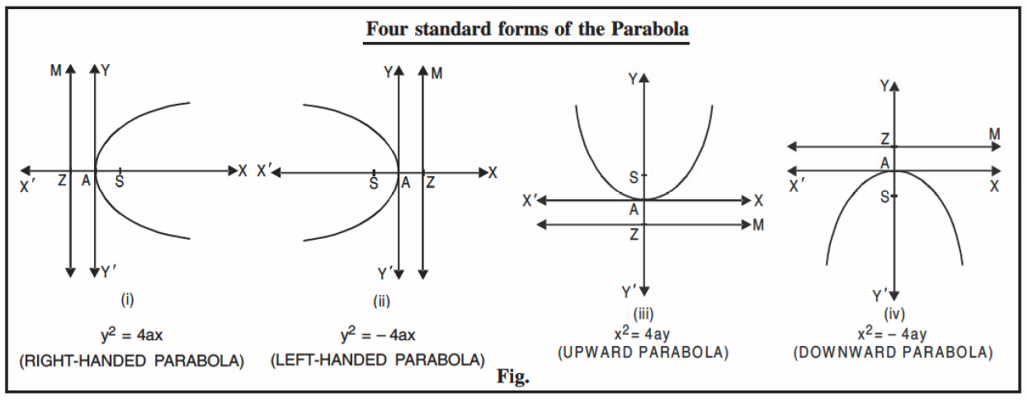

Slide 8
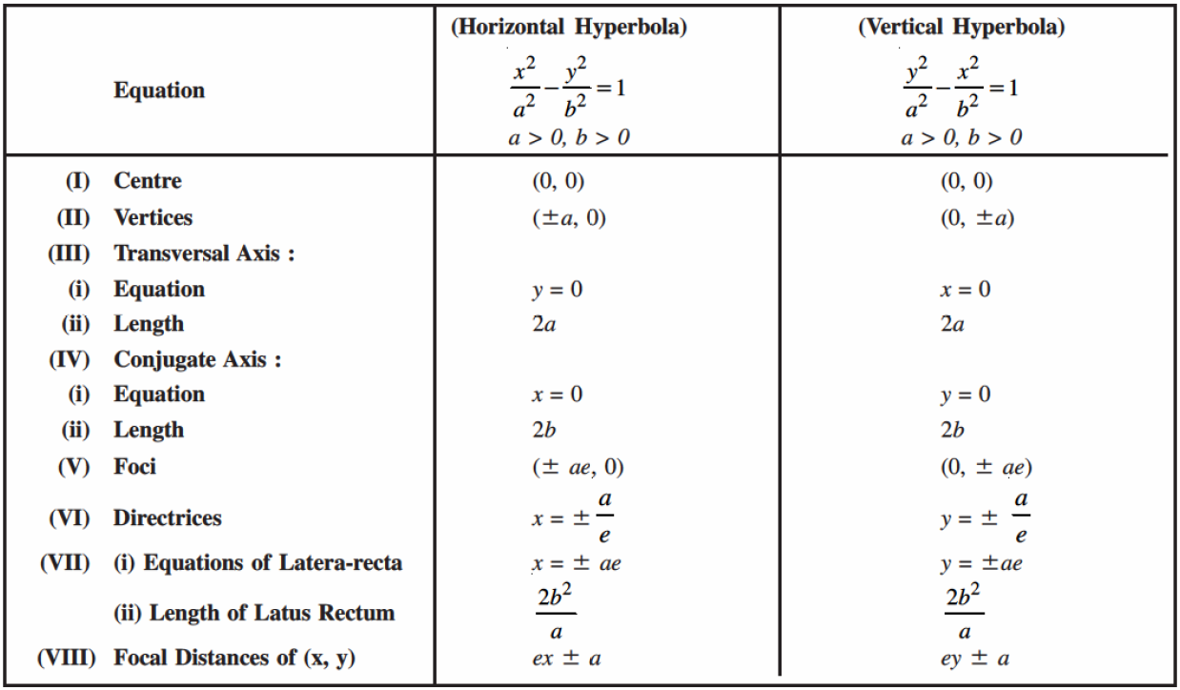
4 Hyperbola

Slide 9
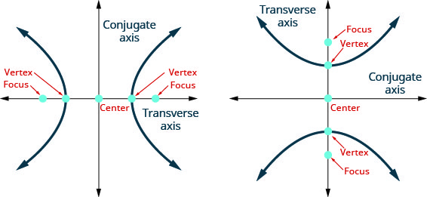

For a hyperbola (or ellipse) the eccentricity is >1
$\boxed{e=\sqrt{1+\frac{b^{2}}{a^{2}}}=\frac{c}{a}}$

Slide 10
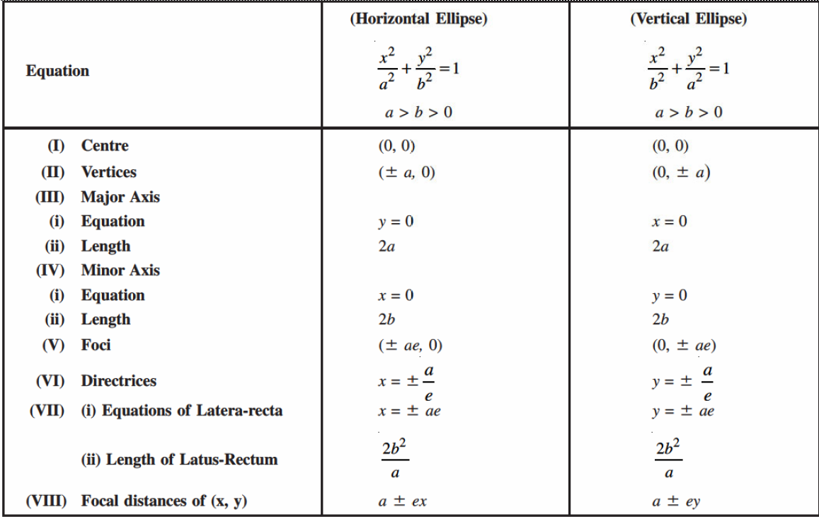
5 Ellipse

Slide 11
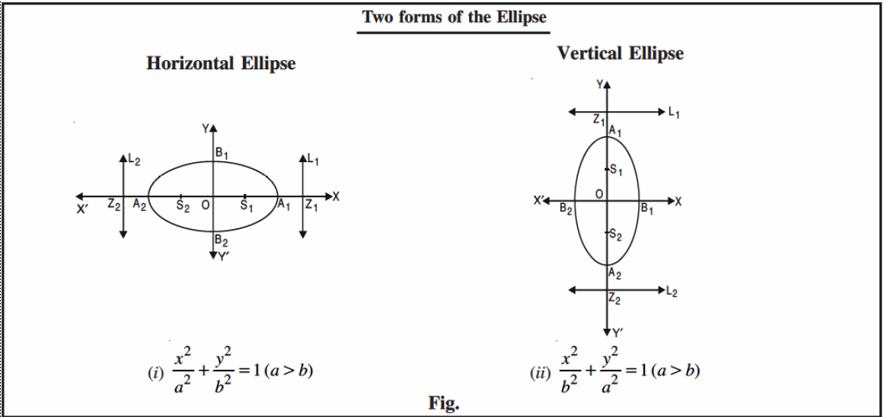

The linear eccentricity (distance between the foci) is given by
$\boxed{c=\sqrt{|a^{2}−b^{2}|}}$ and eccentricity is given by $\boxed{e=\frac{c}{a}}$
ei

Slide 12
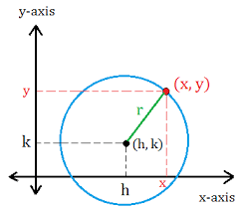

6 Circle
Circle is a special case of an ellipse where major axis and minor axis are equal
An equation of circle can be given by one of the following ways
$\boxed{{\left(x−p\right)}^{2}+{\left(y−q\right)}^{2}=r^{2} }$ Here, center is O(p,q) and radius is r
$\boxed{x^{2}+y^{2}+2fx+2gy+k=0}$ Here Center is $O\left(−f,−g\right), radius=\sqrt{g^{2}+f^{2}−k}$

Slide 13
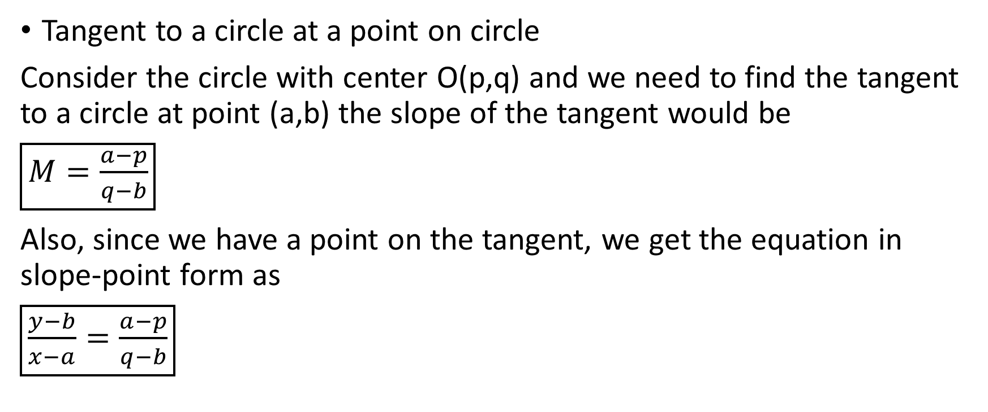
7 More on circles.
Tangent to a circle at a point on circle
Consider the circle with center O(p,q) and we need to find the tangent to a circle at point (a,b) the slope of the tangent would be
$\boxed{M=\frac{a−p}{q−b}}$
Also, since we have a point on the tangent, we get the equation in slope-point form as
$\boxed{\frac{y−b}{x−a}=\frac{a−p}{q−b}}$

Slide 14
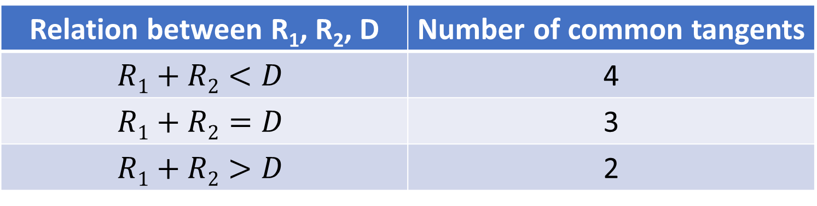
Number of tangents common to two circles
Let the two circles be C1{Center O₁(a₁,b₁) ; Radius R₁} and
C2{Center O₂(a₂,b₂) ; Radius R₂} and let the distance between the centers be D
Step 1 : Obtain the distance D by distance formula for O₁ and O₂.
Step 2 : Look-up table below shows the number of common tangents
Relation between R₁, R₂, D | Number of common tangents
$$R1+R2<D$$ | 4
$$R1+R2=D$$ | 3
$$R1+R2>D$$ | 2

Slide 15
Thank you
Shreyas M
B.Tech in ECE PES University Bangalore

